Slide 1



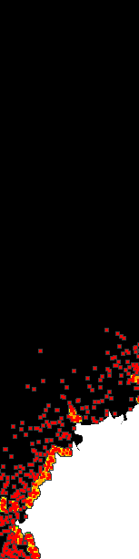
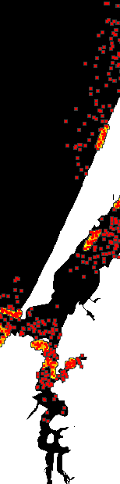

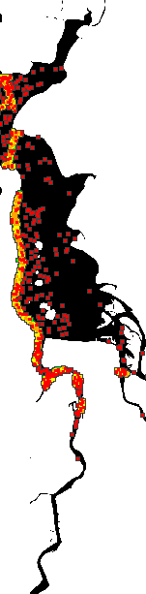
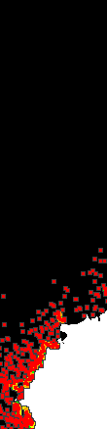
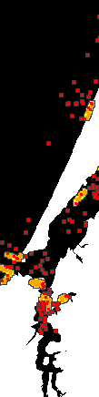
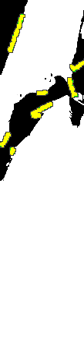
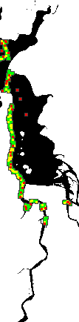
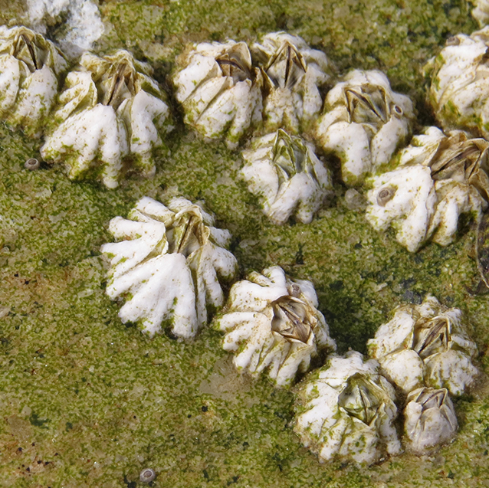
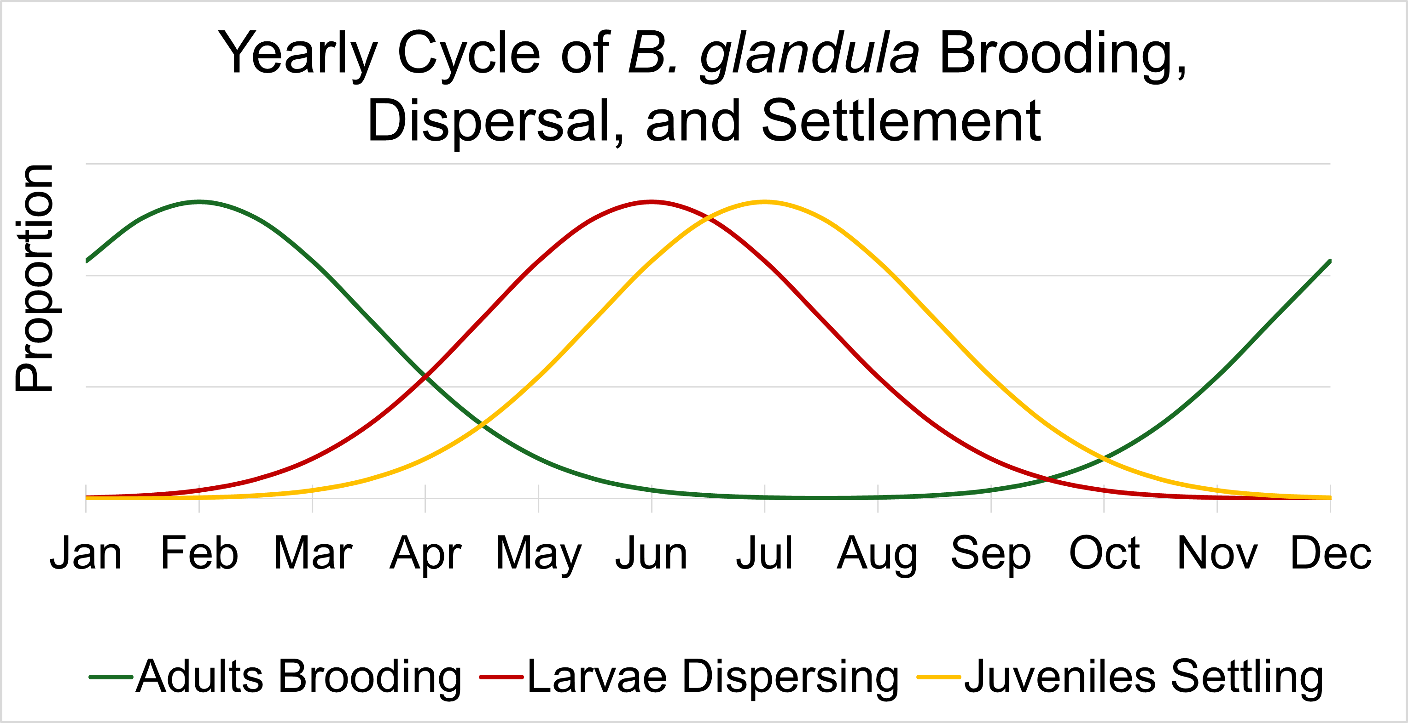
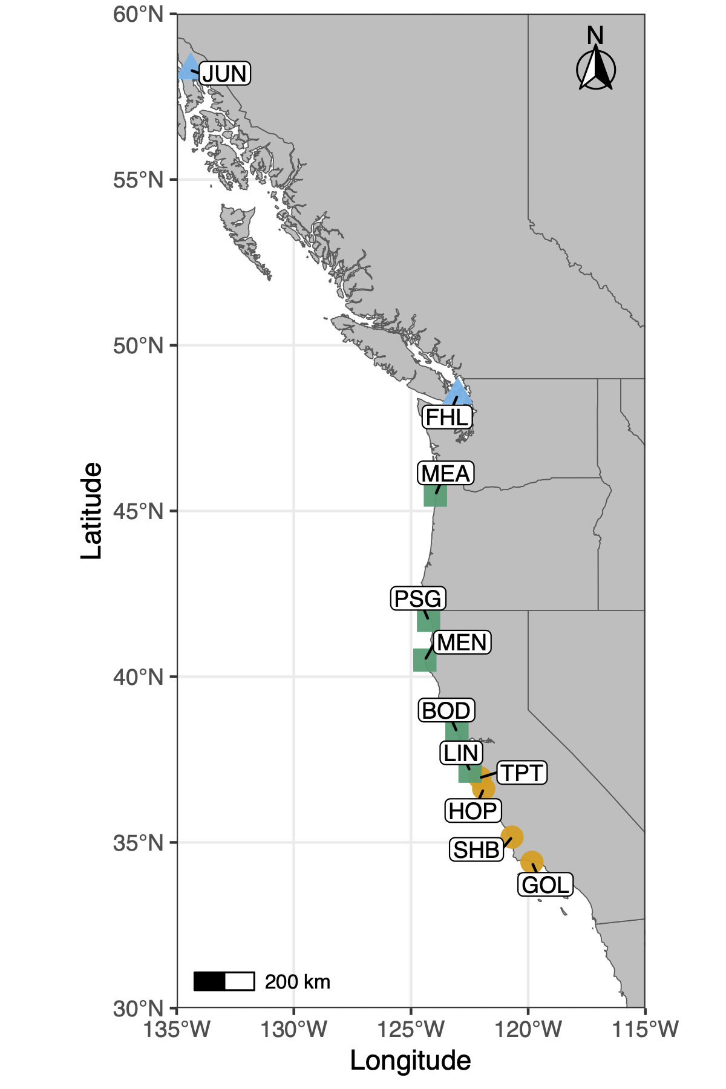
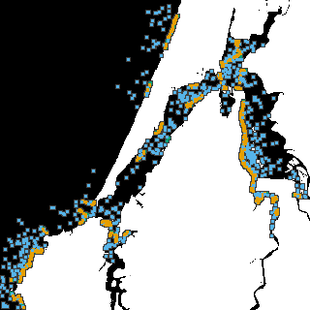
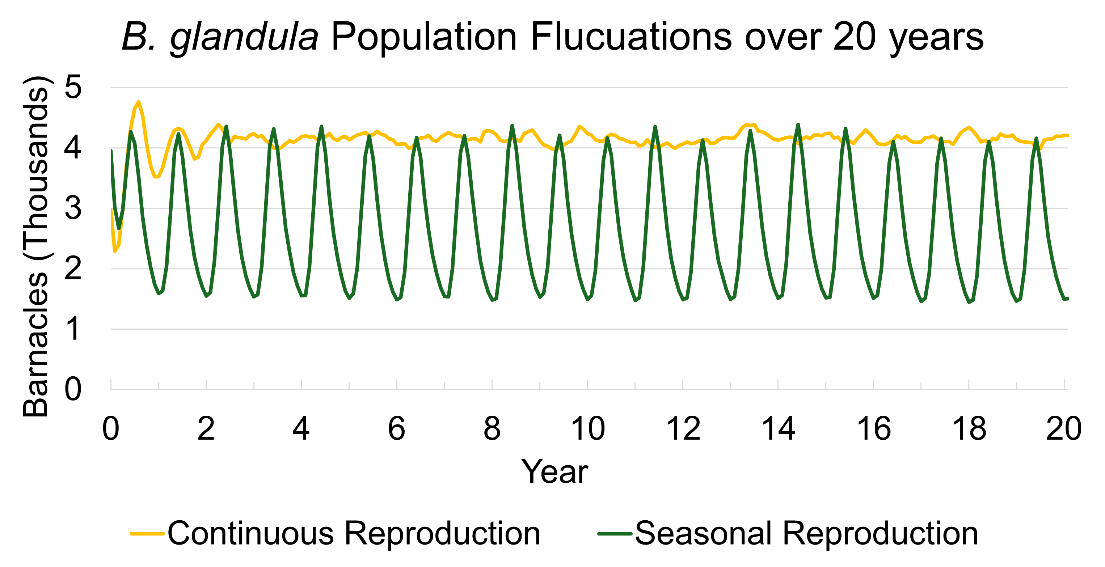
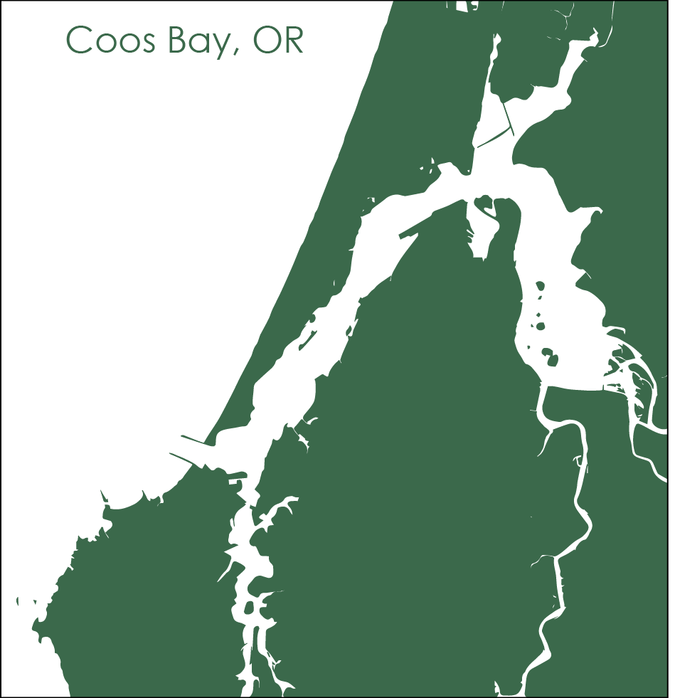
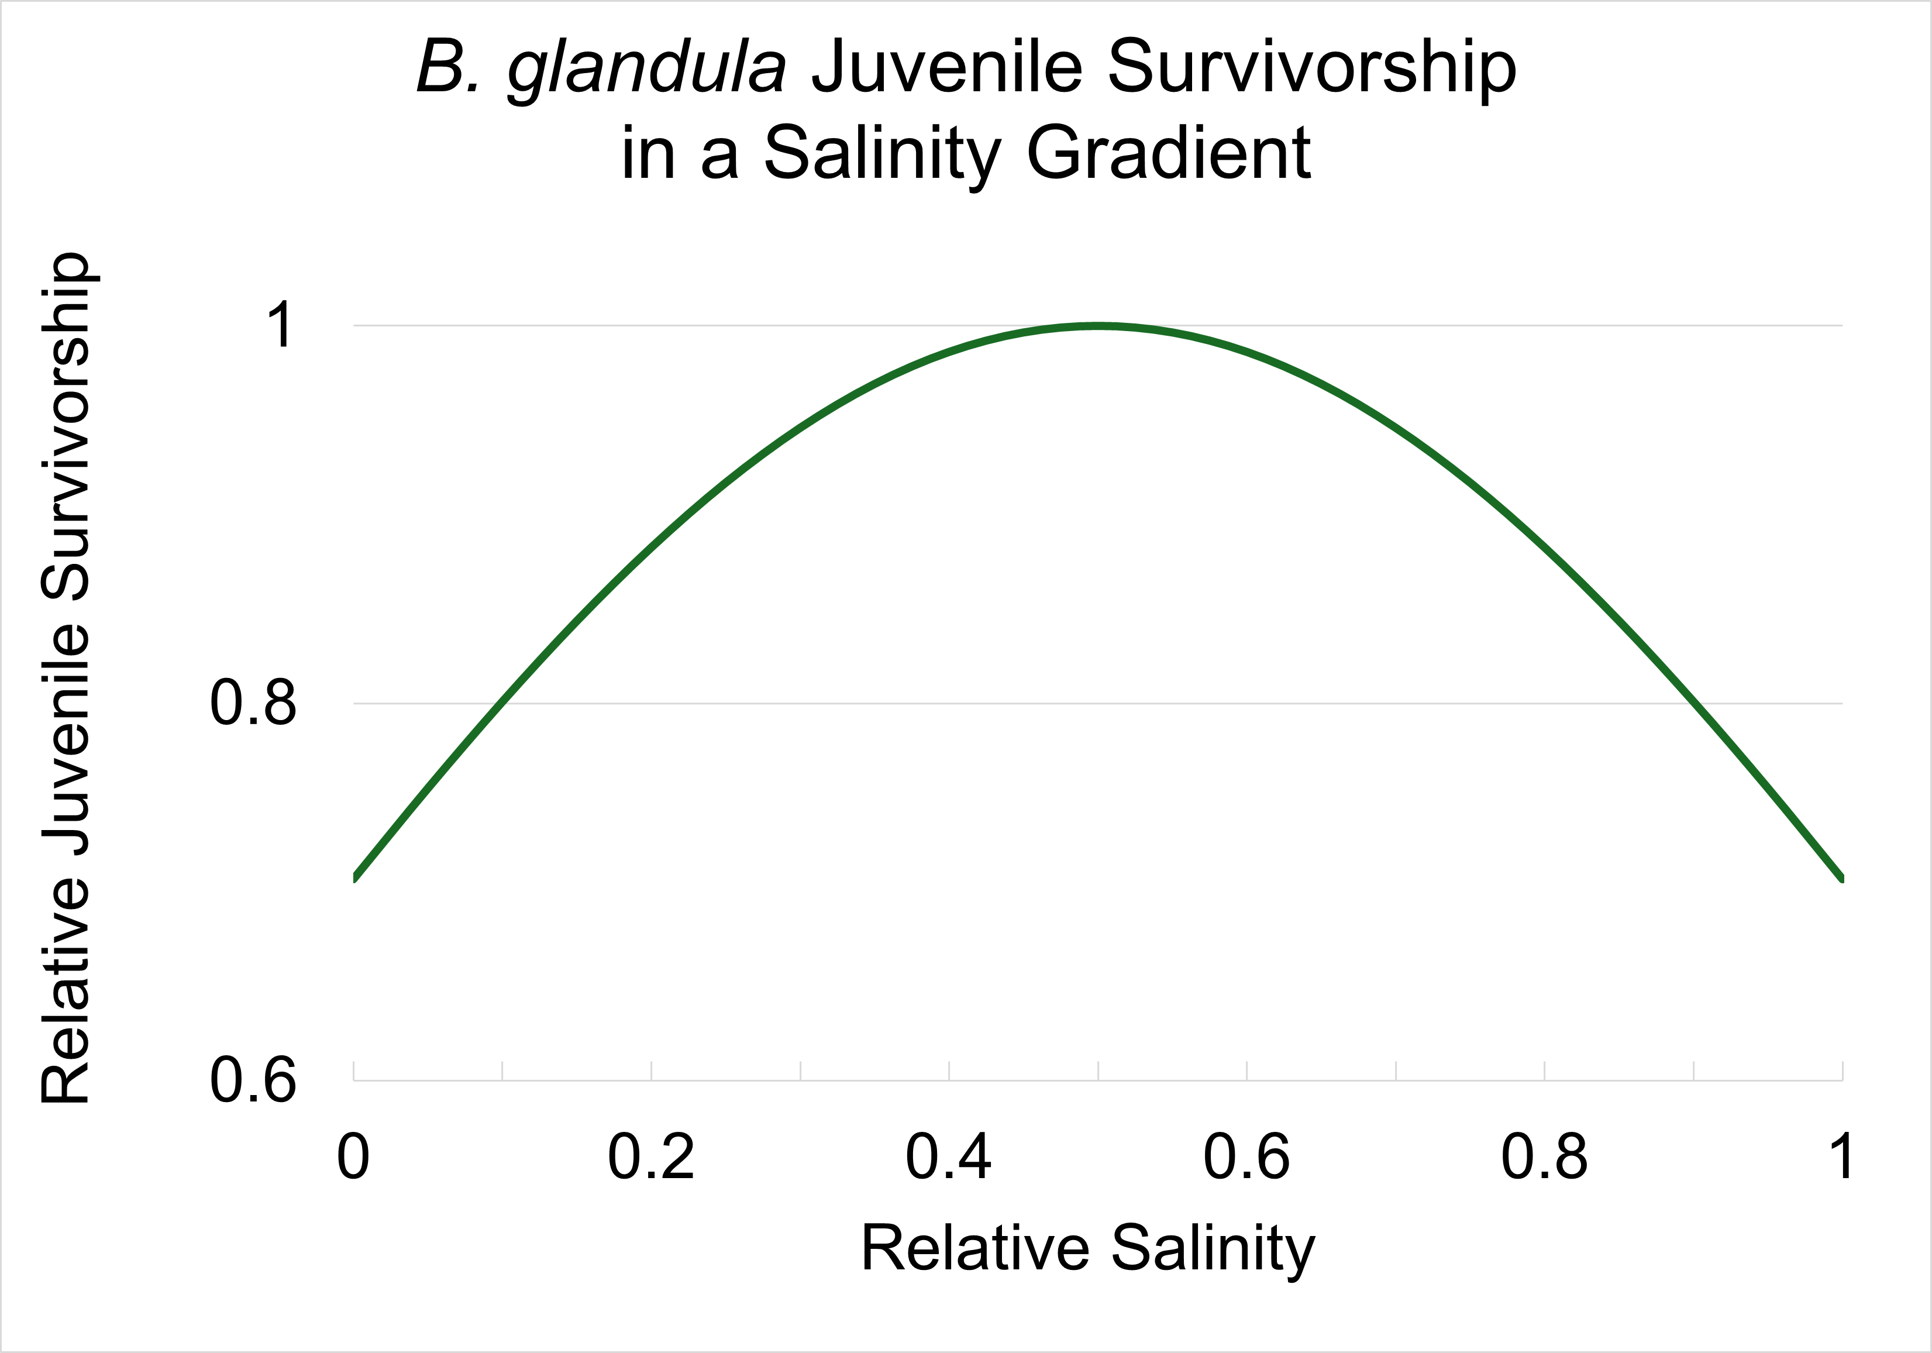
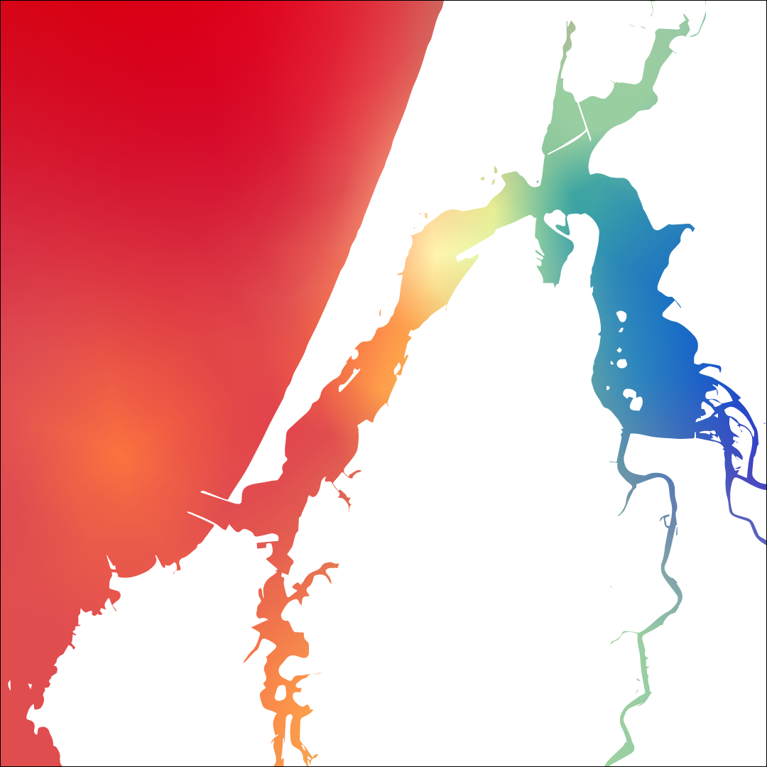

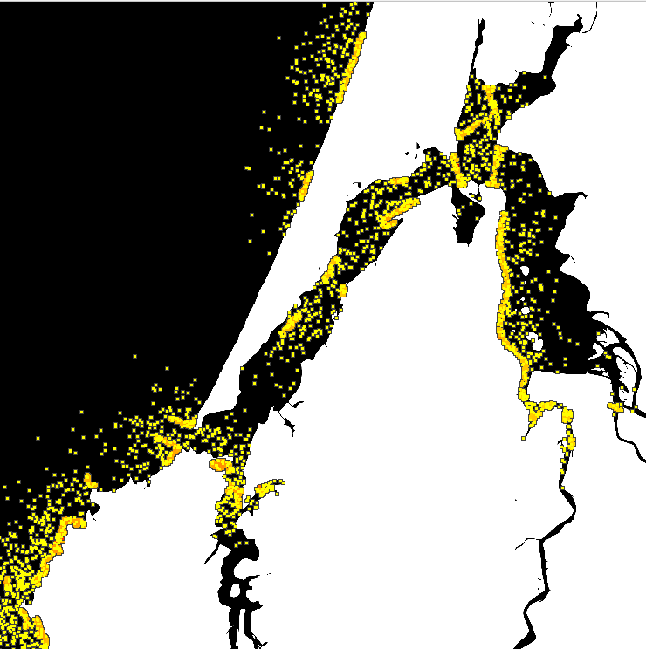
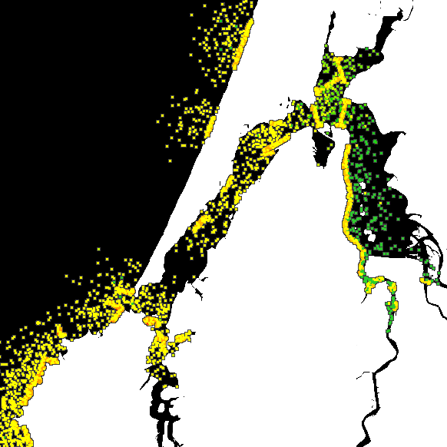
What a Load of Barnacles: A Spatial Population Genomic Simulation Measuring Evolution at Large Scales
Alex Bangs¹, Angel Rivera-Colón¹, Jiseon Min¹, Peter Ralph^{1,2}
¹ Institute of Ecology and Evolution, University of Oregon, Eugene, Oregon, USA, ² Department of Mathematics, University of Oregon, Eugene, Oregon, USA
B. glandula Yearly Population Fluctuations
Continuous Reproduction
Seasonal Reproduction
What, where, and why?
How do we model population genomics for the Pacific acorn barnacle (Balanus glandula)?
Recap/Conclusion:
Model the life cycle and reproduction of B. glandula
Model the fitness effects of environmental variables
Developed the platform to conduct research on B. glandula in estuarine settings
What: the Pacific acorn barnacle
Reproduction
Seasonal brooding occurs in the late winter with larval dispersal occurring after ~4 months, during the summer
“We develop computational simulations of biological systems to expand our understanding of population genomics”
Jun
Sept
Dec
Mar
Jun
Sept
Dec
Mar
Larvae
Juveniles
Adults
Now that we have a working simulation, what comes next?
“As the sculptor carves a masterpiece out of stone, the computational biologist carves a barnacle out of a blob”
Expanding the biological scope
Use the simulation to study the genomic variation of Pacific acorn barnacle populations across the Pacific coast
© Martin Arregui
Expand the library of biological simulations
Science is a collaborative process, and constructing new simulations involves building off previous work
The variables and scenarios we’ve modeled can be adapted to other biological systems and contribute to our understanding of species otherwise unrelated to the Pacific acorn barnacle.
Studying Climate Change
Investigate how changes in ocean temperature and salinity may impact population size, migration, and adaptation in Pacific acorn barnacle populations
Good subject for studying large-scale population genomics
Barnacles are easy to sample, contain significant genetic diversity, and are found across the world
The Pacific acorn barnacle is found from Alaska to Baja California. Learning how the genetic variation and evolution of populations across the range is vital for understanding population genomics
The Impacts of Salinity and Temperature
Juvenile (recently settled) barnacles do best at moderate salinities
Adult barnacles have increased percent brooding (and thus increased offspring) at lower water temperatures
How do we develop our simulation?
Modeling Local Adaptation and Genetic Variation
B. glandula has limited dispersal capabilities, so populations see greater genomic divergence as the distance between them increases
PLACE HOLDER FOR LOCAL ADAPTATION
Acknowledgments
We use SLiM, a software developed by the Messer Lab, to build simulations
Scan the QR code on the right to see this project’s GitHub repository
No Local Adaptation
Local Adaptation to Low Salinity
Thank you to Erin Jesuit of the VonDassow Lab at OIMB for your help collecting and analyzing B. glandula samples. To Dave Sutherland for providing environmental models of Coos Bay, OR, produced by the Sutherland Lab. To the entirety of the Kern Ralph Co-Lab for being a wonderful group to collaborate and research with. To Ben Haller and Philipp Messer for the development of SLiM: An Evolutionary Simulation Framework. And to the University of Oregon Summer Program for Undergraduate Research and the Mary G. Alden Fellowship for the opportunity to pursue summer research.
References
To Be Added
Low Fitness
Moderate Fitness
High Fitness
Notes:
Judges are looking for
Title, Authors and Institutional Affiliation, Hypothesis/Objective, Background, Methods, Results, Conclusions, Future Work, Bibliography, and Acknowledgments
Top Section: Title, Authors, and Institutional Affiliation
Left Section: Background, Methods (QR code to barnacle sim repository)
Background:
Line about what the Kern-Ralph Co-Lab does
Line about Wares’ work studying the Pacific coast cline
Line about what I have been doing within the Lab
Then what are the barnacles and where are they found
How are we modeling (SLiM)
Mention here’s a QR code to the GitHub repository if anyone wants to look at the nitty-gritty of our work.
Middle Section: Objective, Methods, Results
Objective: Develop model of the Pacific acorn barnacle and biologically-relevant environmental variables that isn’t computationally-expensive
What do we need to implement to accurately model B. glandula
Reproduction and Dispersal based on observations in the area
What biologically-relevant environmental variables do we need to find data for and implement?
Salinity and Temperature
What success have we seen so far?
Modeling variations in reproductive window
Implementing local adaptation
Reproduction
Sexual reproduction with neighbors, producing multiple broods a year
Seasonal brooding occurs in the late winter with larval dispersal occurring after ~4 months, during the summer
Impact of Salinity and Temperature
Current literature suggests juvenile (recently settled) barnacles do best at moderate salinities.
Adult barnacles have higher percent brooding (and thus increased offspring) at lower water temperatures.
Modeling Local Adaptation
B. glandula has limited dispersal capabilities, so populations see greater genomic divergence as the distance between them increases
Right Section: Conclusions, Future Work, Acknowledgements, Bibliography
Conclusion
We’ve successfully modeled the life cycle and reproduction methods of B. glandula
We’ve modeled the effects of biologically-relevant environmental variables on fitness
Developed the platform to conduct research on B. glandula in estuarine settings
Future Work:
Expanding the scope
We can now observe the genomic cline across Pacific acorn barnacle populations
Our future work will involve applying this simulation to other Pacific coast populations to examine the cause of this cline
Examine Climate Change Impacts
Ocean acidification impacts carapace growth
Impacted by changing temperature and Salinity
Very numerous and widespread, good model organism for studying adaptation to changing environments
Acknowledgements:
Thanks to Erin Jesuit at the Oregon Institute for Marine Biology,
Dave Sutherland of the Oceans & Ice Lab
Ben Haller and Philipp Messer for developing SLiM
And the University of Oregon Summer Program for Undergraduate Research and the Mary G. Alden Fellowship for research funding

